Slide 1
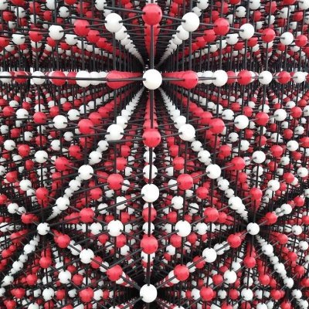
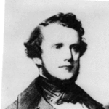
BPM: 2 Engineering Physics-II
UNIT –I: Crystal Structures and X-ray Diffraction
Lecture-4
By- Prof. B. K. Pandey, Dept. of Physics and Material Science
Auguste-Bravais

Slide 2

Coordination Number
Coordination Number (CN) : The Bravais lattice points closest to a given point are the nearest neighbours.
Because the Bravais lattice is periodic, all points have the same number of nearest neighbours or coordination number. It is a property of the lattice.
A simple cubic has coordination number 6;
A body-centered cubic lattice, 8;
A face-centered cubic lattice,12.

Slide 3
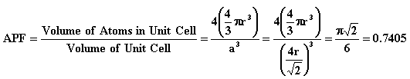
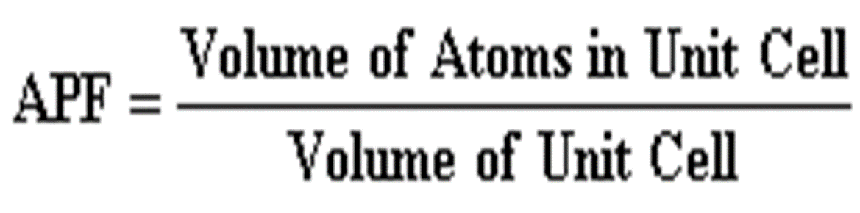
Atomic Packing Factor
Atomic Packing Factor (APF) is defined as the volume of atoms within the unit cell divided by the volume of the unit cell.

Slide 4
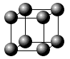
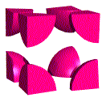


1-CUBIC CRYSTAL SYSTEM
a- Simple Cubic (SC)
Simple Cubic has one lattice point so its primitive cell.
In the unit cell on the left, the atoms at the corners are cut because only a portion (in this case 1/8) belongs to that cell. The rest of the atom belongs to neighboring cells.
Coordinatination number of simple cubic is 6.
b
c
a

Slide 5
Atomic Radius for SC
It is half the distance between any two nearest neighbors in the given crystal structure.
It is expressed in terms of cube edge a
a = 2r,
r = a/2
Atomic Radius, r = 0.5a
a

Slide 6
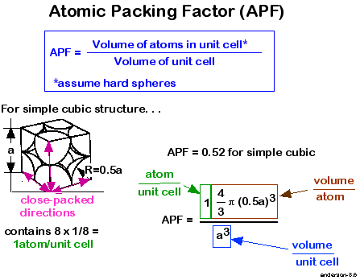
Atomic Packing Factor of SC

Slide 7
Discussions
APF = 0.52
That means that the percentage of packing is 52%
Thus, 52% of the volume of the simple cubic unit cell is occupied by atoms and the remaining 48% volume of unit cell is vacant or void space.

Slide 8
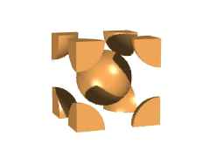
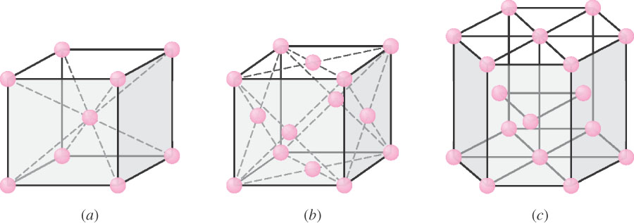
b-Body Centered Cubic (BCC)
BCC structure has 8 corner atoms and 1 body centre atom.
Each corner atom is shared by 8 unit cells.
The center atom is not shared by any of the unit cells.
So the
Number of atoms per unit cell
n = (1/8)x8 +1 = 2
b
c
a

Slide 9
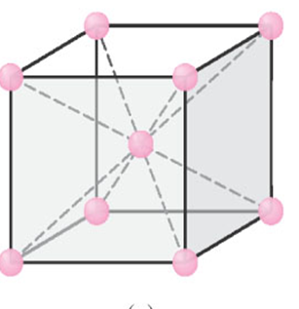
b-Body Centered Cubic (BCC)
BCC has two lattice points so BCC is a non-primitive cell.
BCC has eight nearest neighbors. Each atom is in contact with its neighbors only along the body-diagonal directions.
Hence, the coordination no. for BCC unit cell is 8
Many metals (Fe,Li,Na..etc), including the alkalis and several transition elements choose the BCC structure.
b
c
a

Slide 10
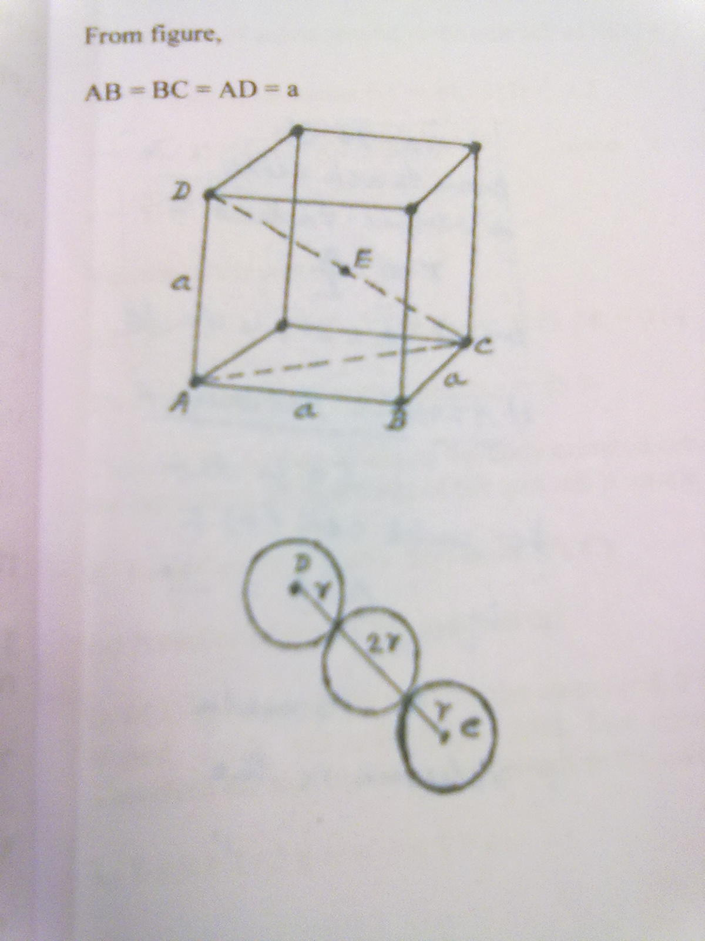
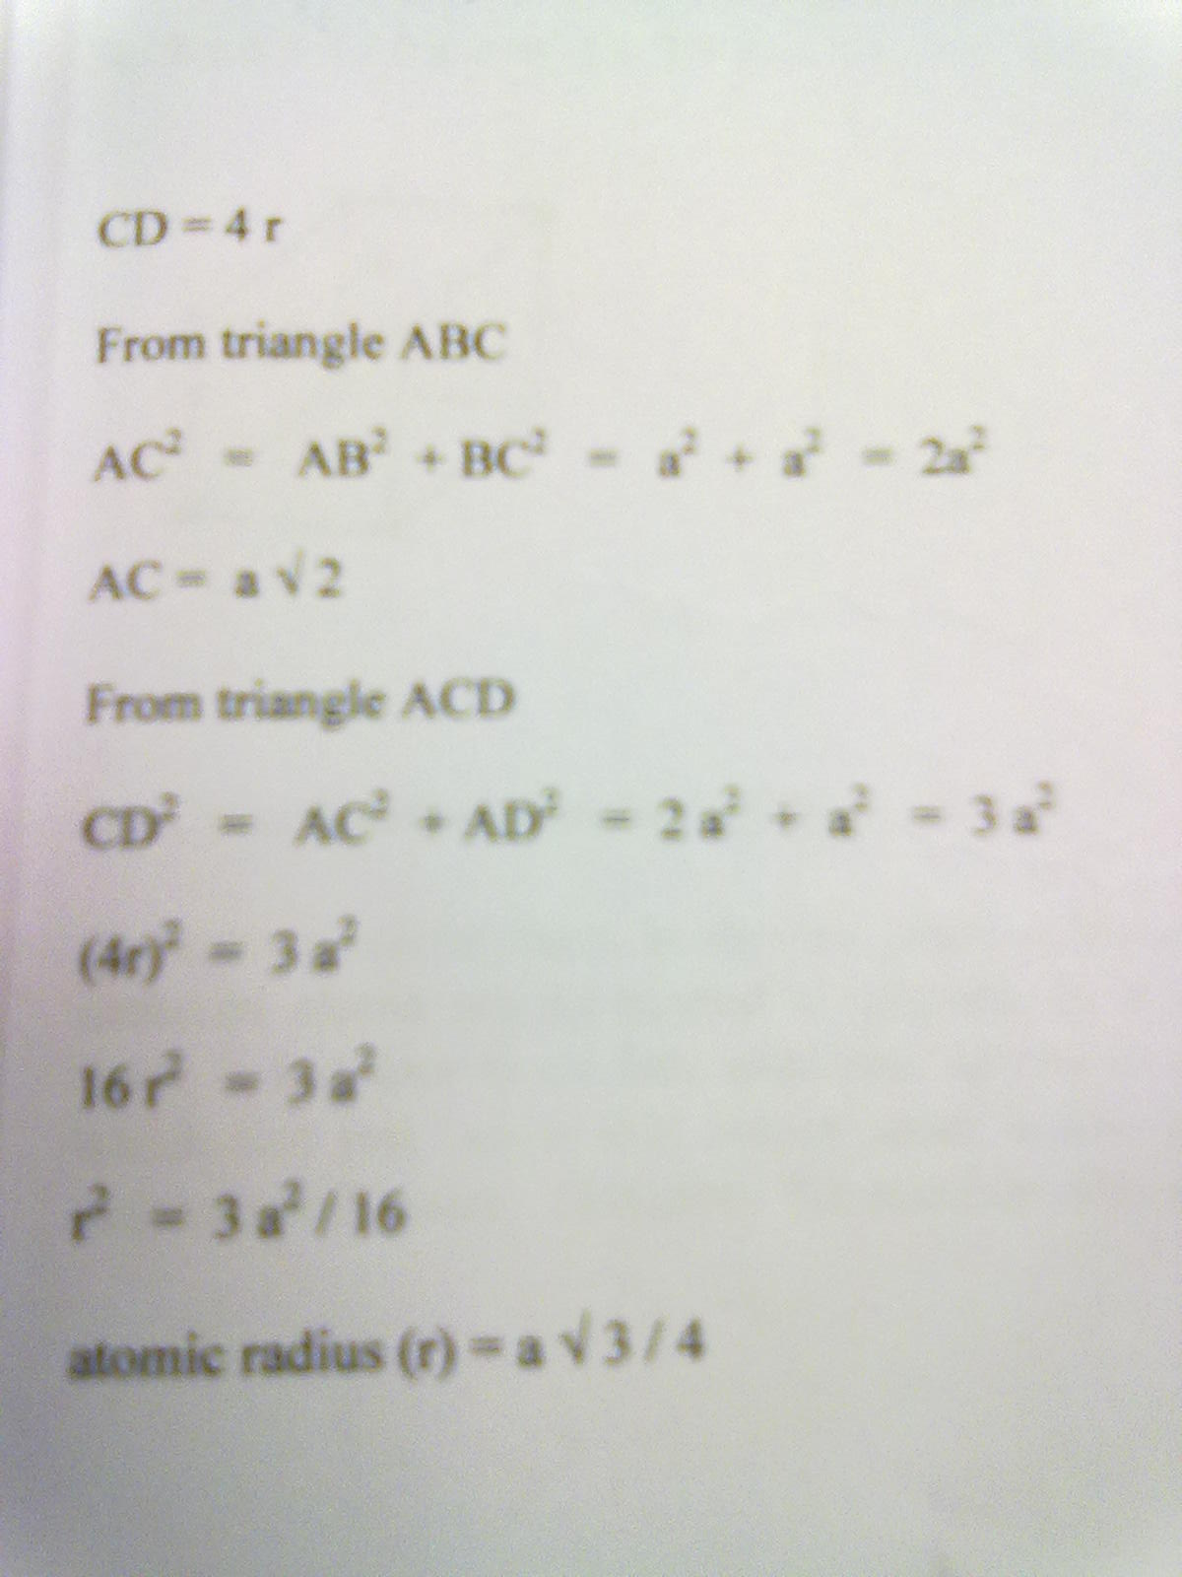
Atomic Radius for BCC unit cell
r =a x (3)^{1/2}/4

Slide 11
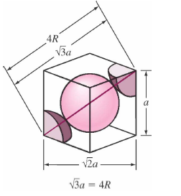
Atomic Packing Factor of BCC
2
(0,433a)

Slide 12
Atomic Packing Factor of BCC
The percentage of packing for BCC structure is 68%
Thus , 68% of the volume of body centered cubic cell is occupied by atoms and the remaining 32% of the volume is vacant or void space

Slide 13
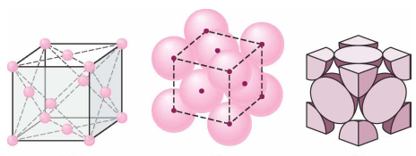
c- Face Centered Cubic (FCC)
FCC structure has 8 corner atoms and 6 face centre atoms.
Each corner atom is shared by 8 unit cells.
Each face centered atom is shared by 2 unit cells.
So the
Number of atoms present in unit cell is
n = (1/8 x8) + (1/2 x 6)
= 1 + 3
= 4

Slide 14
Co ordination Number
Face Centered Cubic (FCC)
The corner atom in its own plane touches 4 face centred atoms.
In the plane just above, the corner atom has another 4 face centered atoms as its nearest neighbours
Similarly, in the plane just below it has 4 more face centered atoms as its nearest neighbours
Therefore the no. of nearest neighbours are :
4 + 4 + 4 = 12

Slide 15
Many of common metals (Cu,Ni,Pb..etc) crystallize in FCC structure.

Slide 16
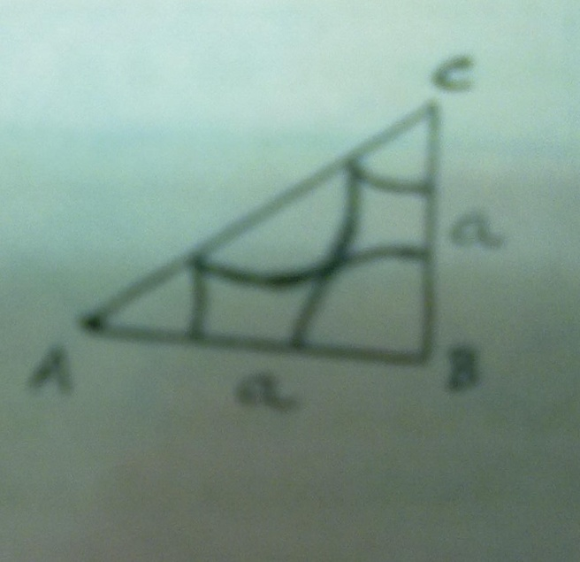
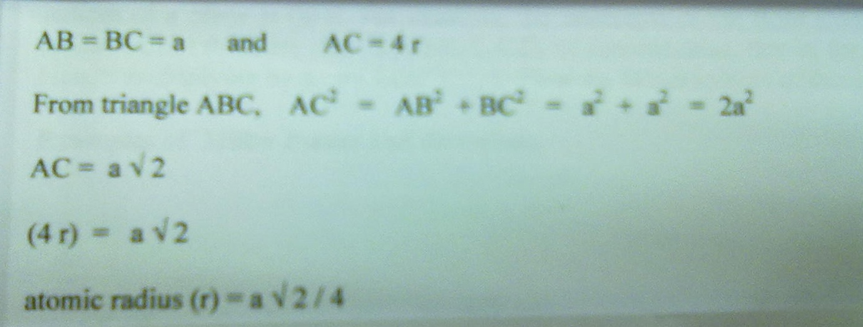
Atomic Radius for FCC
r = a x (2)^{1/2}/4

Slide 17
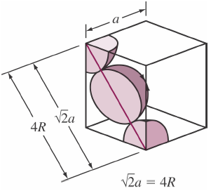
Atomic Packing Factor of FCC
0.74
FCC
4
(0.353a)

Slide 18
Unit cell contents
Counting the number of atoms within the unit cell
Atoms Shared Between: Each atom counts:
corner 8 cells 1/8
face centre 2 cells 1/2
body centre 1 cell 1
lattice type cell contents
P 1 [=8 x 1/8]
I 2 [=(8 x 1/8) + (1 x 1)]
F 4 [=(8 x 1/8) + (6 x 1/2)]

